Slide 1
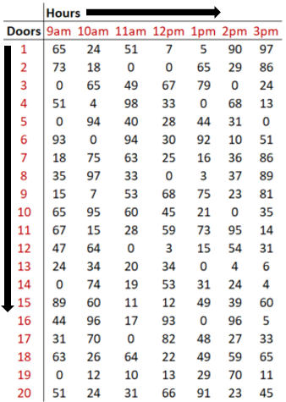
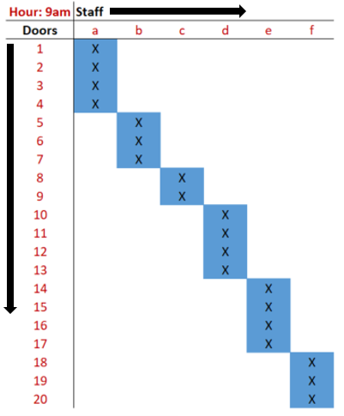



Distribute Overview
Input
Output
Allocation
Execution
Results
Distribute pulls in data from facility’s sorting system, showing upcoming volume levels across the facility.
Distribute creates a report for the manager containing the optimal assignment of their team to areas of the facility.*
Managers inform their team of the new assignments.
Team members work their assigned area until the next assignment.
Facility performance improves, leading to lower costs and higher workforce utilization
*areas may constitute sets of doors, lanes, bays, etc.

Slide 2
Diagnostic
Preliminary evaluation to determine how Distribute fits within your current process. Capability demonstration using a small subset of existing data.
Pilot
Distribute is operationalized for a small section of the facility. Typically lasting one week to one month in duration.
Adjustments
Based on lessons learned during the pilot phase, back-end or front-end adjustments will be made to ensure Distribute is a solution that meets your specific needs.
Implementation
Begin implementing Distribute across the facility, through incremental phases. Deliver product and training to management team.
1
2
3
4

